Slide 1
DATA ANALYSIS IN HEART FAILURE PREDICTION
MARRIAM JARWAR
CSC-21F-059

Slide 2
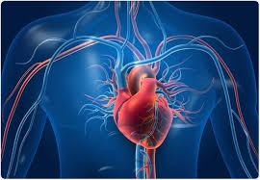
Introduction:
Heart Failure (HF):
A prevalent cardiovascular condition with high morbidity and mortality.
Early detection and prediction can enable timely interventions, improving outcomes and reducing costs.

Slide 3
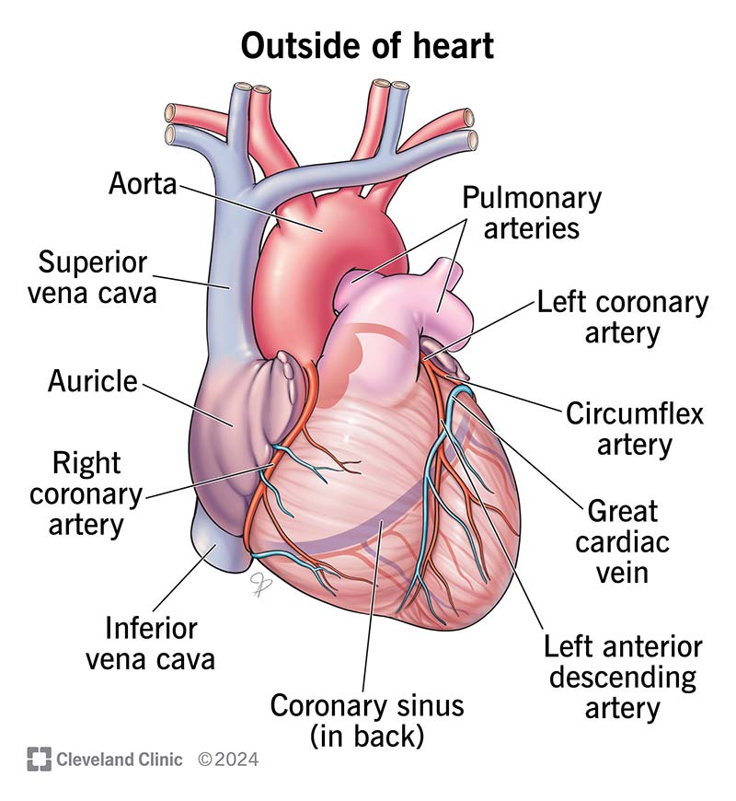
Study Objective:
Goal:
Develop a machine learning-based approach to predict heart failure.
Utilize clinical and demographic variables.

Slide 4

Dataset:
Data Sources:
Clinical and demographic information of heart failure patients.
Variables: Age, Gender, Blood Pressure, Ejection Fraction, Comorbidities.]

Slide 5
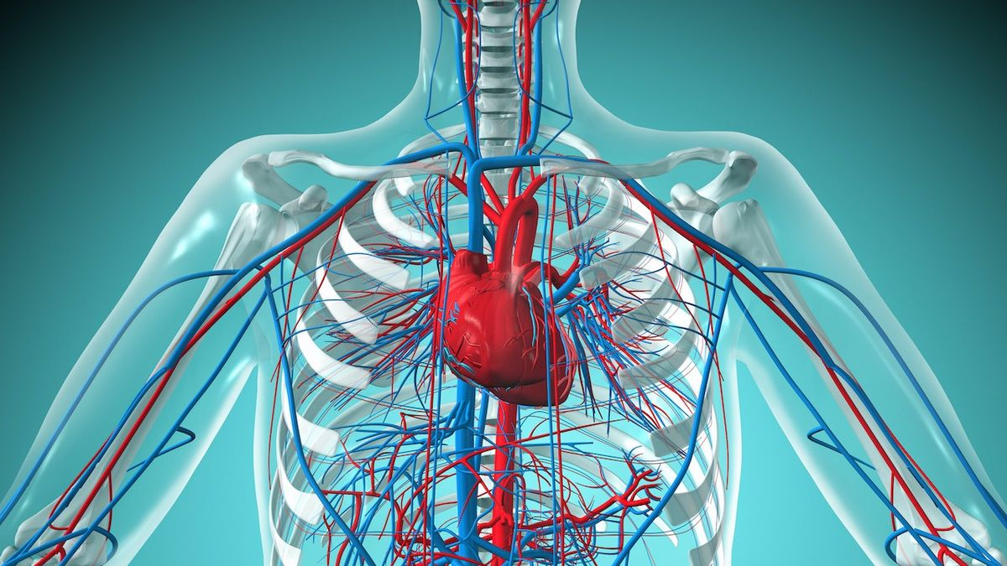
Data Preprocessing:
Steps:
Handling missing values.
Standardizing numerical variables.
Encoding categorical variables.
Splitting into training and testing sets.

Slide 6

Machine Learning Algorithms:
Algorithms Evaluated:
Logistic Regression
Decision Tree
Random Forest
Support Vector Machine (SVM)
K-Nearest Neighbors (KNN)
Naive Bayes

Slide 7

Results:
Model Performance:
Random Forest: 1.00 Accuracy
Decision Tree: 0.99 Accuracy
Support Vector Machine: 0.93 Accuracy
K-Nearest Neighbors: 0.90 Accuracy

Slide 8
Feature Selection:
Techniques Used:
Recursive Feature Elimination (RFE)
Principal Component Analysis (PCA)

Slide 9
Conclusion:
Key Findings:
Random Forest achieved the highest accuracy.
Effective identification of high-risk individuals.
Facilitates proactive healthcare measures.

Slide 10
Future Directions:
Next Steps:
Incorporate genetic data.
Conduct longitudinal studies.
Further refine predictive accuracy and clinical applicability.

Slide 11
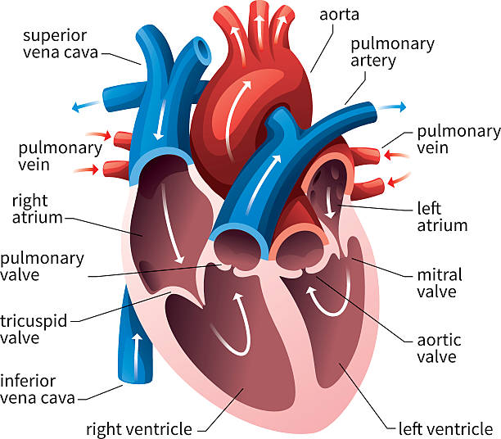
Impact:
Contribution to Precision Medicine:
Enhancing the quality of care for cardiovascular patients through advanced predictive analytics.

Slide 12
END!!

